Slide 1
Pythagoras Theorem Revision
J. Wilson

Slide 2
Quickwrite
What is Pythagoras’ Theorem and how do we use it?
Share your quickwrite with your neighbour
Popcorn

Slide 3
Okay, let’s see if you were right.

Slide 4
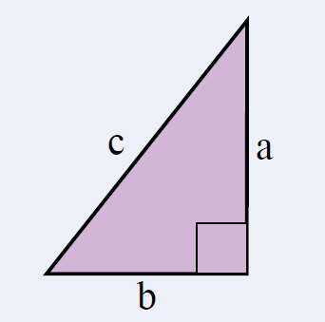

24
7
30
Topic: Pythagoras Theorem
Date: /06/2018
EQ – What is the Pythagoras Theorem?
For any right-angled triangle:
The square on the hypotenuse is equal to the sum of the squares on the other two sides
The hypotenuse is the longest side of a right-angled triangle.
It is opposite the right angle.

Slide 5
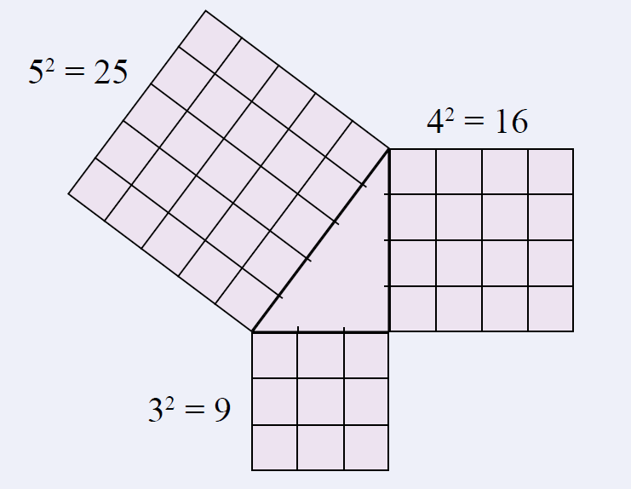
24
7
30
Topic: Pythagoras Theorem
Date: /06/2018
EQ – What is the Pythagoras Theorem?
For any right-angled triangle:
The square on the hypotenuse is equal to the sum of the squares on the other two sides
Example:

Slide 6

We Do
What side is the hypotenuse?
Determine the length of the hypotenuse.
Answers
The hypotenuse is side f.
d = 12cm
e = 5cm
$$f^{2}=d^{2}+e^{2}$$
$$f^{2}={12}^{2}+5^{2}$$
$$f^{2}=144+25$$
$$f^{2}=169$$
$$f=\sqrt{169}$$
$f=13$ cm
f

Slide 7
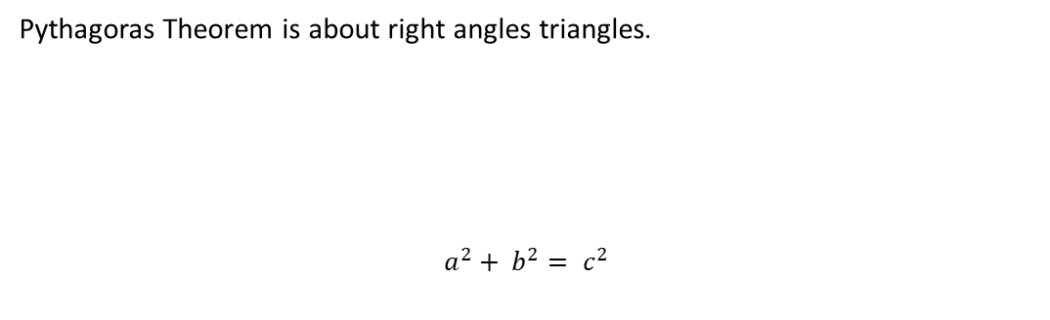


24
7
30
Topic: Pythagoras Theorem
Date: /06/2018
EQ – How do I calculate the shorter side of a right-angled triangle?
Pythagoras Theorem is about right angles triangles.
$$a^{2}+ b^{2}= c^{2}$$
c
a
b
Therefore to find the shorter sides:
$${ a}^{2}=c^{2}−b^{2}$$
or
$$a= \sqrt{c^{2}− b^{2} }$$

Slide 8




24
7
30
Topic: Pythagoras Theorem
Date: /06/2018
EQ – How do I calculate the shorter side of a right-angled triangle?
shorter side
$$x^{2}= {20.4}^{2}− {9.6}^{2}$$
$=416.16−92.16$
$$=324$$
$$9.6 cm$$
$$x$$
$$x= \sqrt{324}$$
$=18 cm$
$$20.4 cm$$
hypotenuse

Slide 9

We Do
Determine the length of the unknown side of this right-angled triangle.
$$e^{2}=f^{2}−d^{2}$$
$$e^{2}={10}^{2}−8^{2}$$
$$f^{2}=100−64$$
$$f^{2}=36$$
$$f=\sqrt{36}$$
$f=6$ cm
d = 8 m
e
f = 10 m

Slide 10
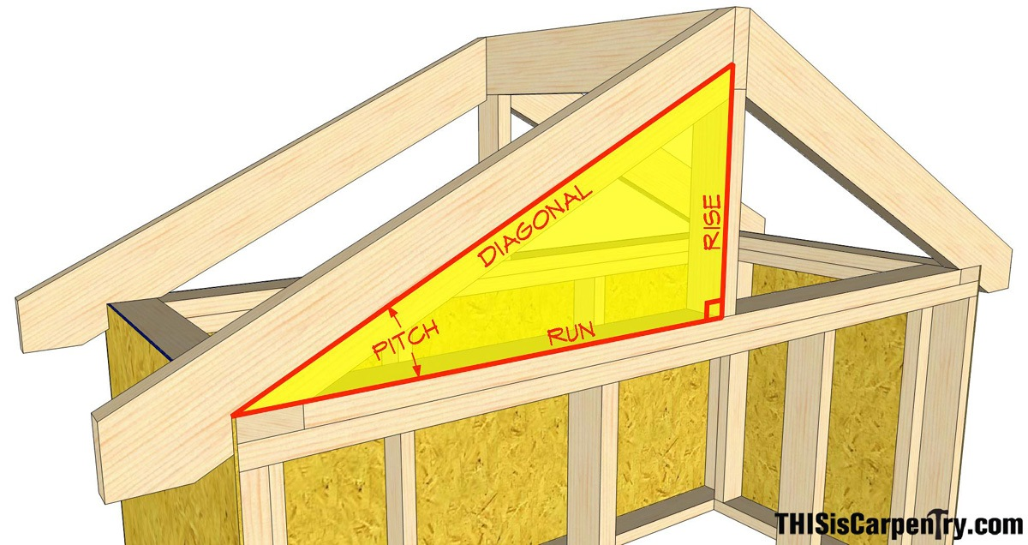
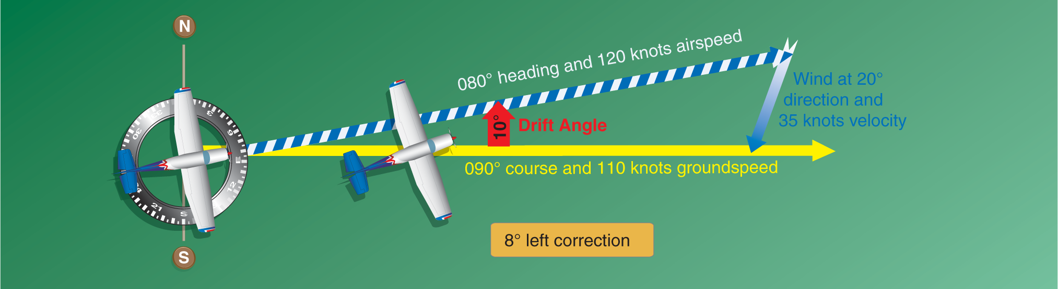
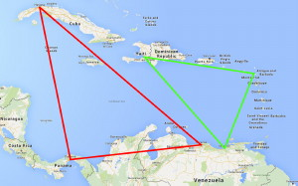
So what is Pythagoras used for?
Construction
Navigation
Mapping

Slide 11
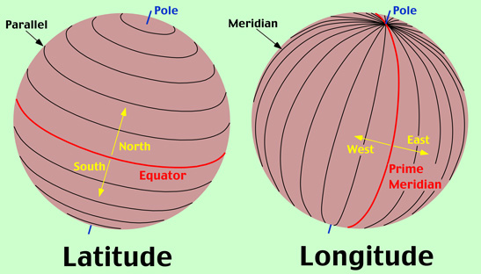
A quick reminder on Geography……
Now it’s time to do a little practice

Slide 12
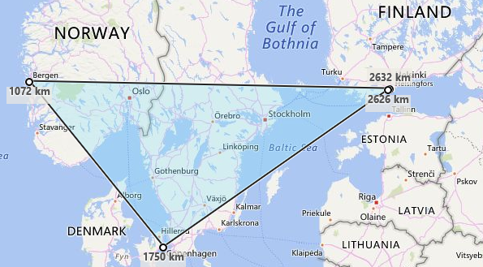


Helsinki and Bergen both lie on the 64º North line of Latitude
Bergen
Helsinki
Together with Copenhagen, they form a right angle triangle.
659 km
886 km
From Helsinki to Copenhagen it is 886km, and from Copenhagen to Bergen it is 659km.
Copenhagen
Use Pythagoras’ Theorem to calculate the distance from Bergen to Helsinki
$$a^{2}+ b^{2}=c^{2}$$
$${659}^{2}+ {886}^{2}=c^{2}$$
There is 25º longitude between Bergen and Helsinki so that makes it 44km for every 1º
${434281+784996}^{}=$ $c^{2}$
$$c= \sqrt{1219277}$$
$$c=1104km$$

Slide 13
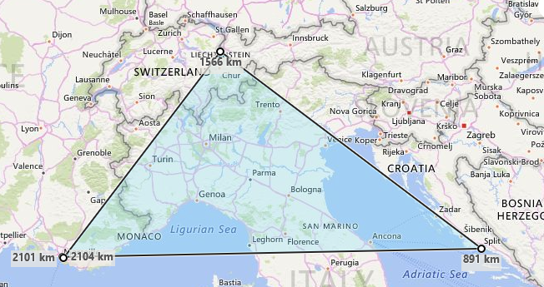


Marseille and Split both lie on the 43º North line of Latitude
Liechtenstein
Together with Liechtenstein, they form a right angle triangle.
544 km
680 km
From Marseille to Liechtenstein it is 544km, and from Liechtenstein to Split it is 680km.
Marseille
Split
Use Pythagoras’ Theorem to calculate the distance from Marseille to Split
$$a^{2}+ b^{2}=c^{2}$$
$${544}^{2}+ {680}^{2}=c^{2}$$
There is 11º longitude between Marseille and Split so that makes it 79km for every 1º
${295936+462400 }^{}=$ $c^{2}$
$$c= \sqrt{758338}$$
$$c=871km$$

Slide 14
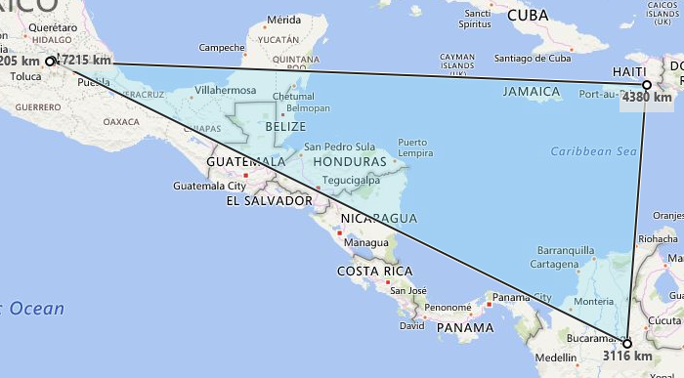


Mexico City and Haiti both lie on the 19º North line of Latitude
Mexico City
Haiti
Together with Bucaramanga
they form a right angle triangle.
1269 km
3116 km
From Bucaramanga to Haiti it is 1269 km, and from Bucaramanga to Mexico City it is 3116 km.
Bucaramanga
Use Pythagoras’ Theorem to calculate the distance from Mexico City to Haiti
$$a^{2}=c^{2}− b^{2}$$
$$a^{2}={3116}^{2 }−{1269}^{2}$$
There is 26.5º longitude between Mexico City and Haiti so that makes it 107km for every 1º
$a^{2}=$ ${9709456}^{}−{1610361}^{}$
$$a= \sqrt{8099095}$$
$$a =2846 km$$

Slide 15
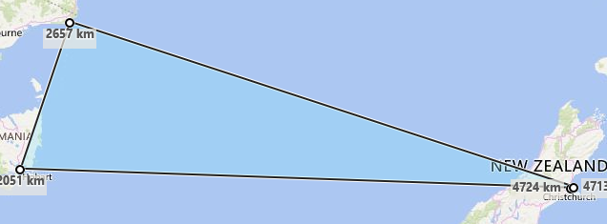


Hobart and Christchurch both lie on the 43º South line of Latitude
Croanjingolong
620 km
2030 km
Together with Croanjingolong Nat. Park they form a right angle triangle.
Hobart
Christchurch
From Croanjingolong to Christchurch it is 2030 km, and from Croanjingolong to Hobart it is 620 km.
Use Pythagoras’ Theorem to calculate the distance from Horbart to Helsinki
$$a^{2}+ b^{2}=c^{2}$$
$${2030}^{2}+ {620}^{2}=c^{2}$$
There is 25º longitude between Hobart and Christchurch so that makes it 85km for every 1º
$4120900{+ 384400 }^{}=$ $c^{2}$
$$\sqrt{4505300}=c$$
$$2122 km=c$$

Slide 16
At 25º N there is 44km between lines of longitude
At 43º N there is 79km between lines of longitude
At 19º N there is 107km between lines of longitude
At 43º S there is 86km between lines of longitude

Slide 17
At 25º N there is 44km between lines of longitude
At 43º N there is 79km between lines of longitude
At 19º N there is 107km between lines of longitude
At 43º S there is 86km between lines of longitude

Slide 18
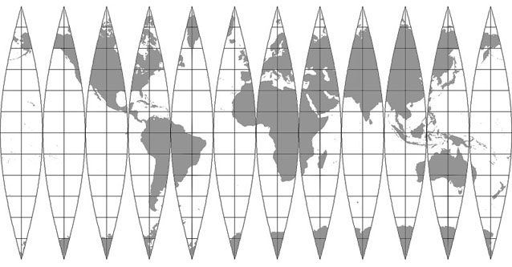
What happens when we bend all the lines of longitude like this?

Slide 19
